Slide 1
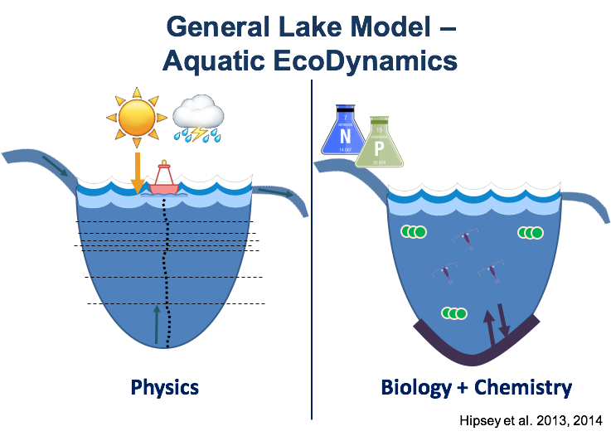




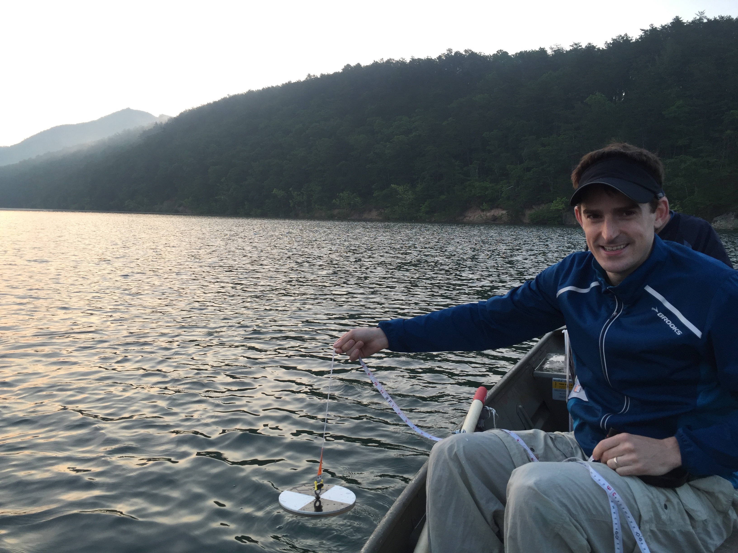
FLARE (Forecasting Lake and Reservoir Ecosystems)
Model
driver data
Initial conditions
for next day’s
simulation
Lake model
16-day
weather
forecast
Model output
Mon
Tues
Weds
Thurs
0%
25%
75%
95%
Update model via
ensemble Kalman filter
Forecast for managers
& decision support tools
Observational
data
Adaptation: Thomas et al., in prep.; Images: A Fowler, Wellograph
Notes:
To summarize one daily time step of our workflow, the meteorological sensor data on github run the GLM model, which generates model output of water temperature that are updated via an Ensemble kaman filter from the observational temperature data. The updated model states serve as the initial conditions for the next day’s simulation, which are fed by NOAA’s GEFS meteorological forecast, which is used as driver data to generate a water quality forecast for the next 16-days.

Slide 2





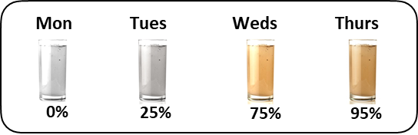
Meteorological and inflow data
as model drivers
Initial conditions
for next day’s
simulation
NOAA 16-day
weather
forecast
Lake model
GitHub
data repository
Model output
Model output
GitHub
data repository
Update model via
ensemble Kalman filter
Forecast for managers
& decision support tools
Observational
data
Feedback from
managers to scientists

Slide 3
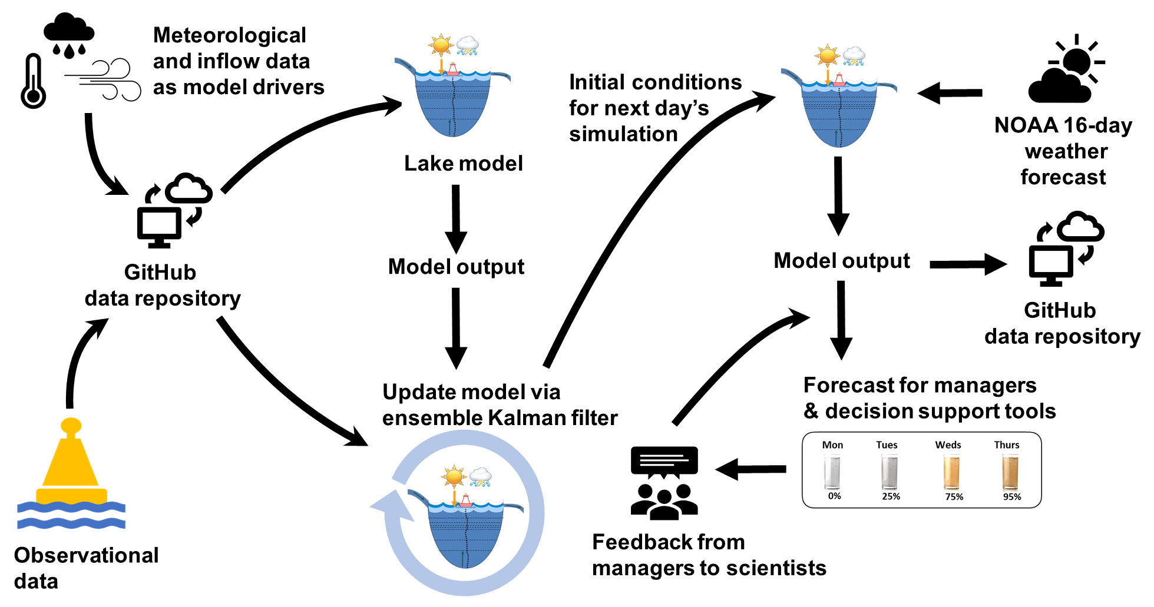

Slide 4






Slide 5


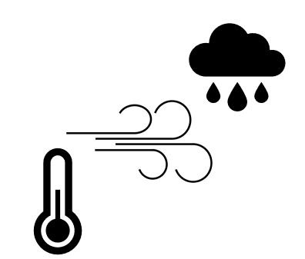

Slide 6



Slide 7
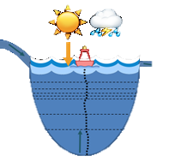
Meteorological and inflow data
as model drivers
Initial conditions
for next day’s
simulation
NOAA 16-day
weather
forecast
Lake model
GitHub
data repository
Model output
Model output
GitHub
data repository
Update model via
ensemble Kalman filter
Forecast for managers
& decision support tools
Observational
data
Feedback from
managers to scientists

Slide 8
